Slide 1
Ansible
Overview of Ansible
Presented By
Karthik Reddy R
Satish K Balaji M

Slide 2
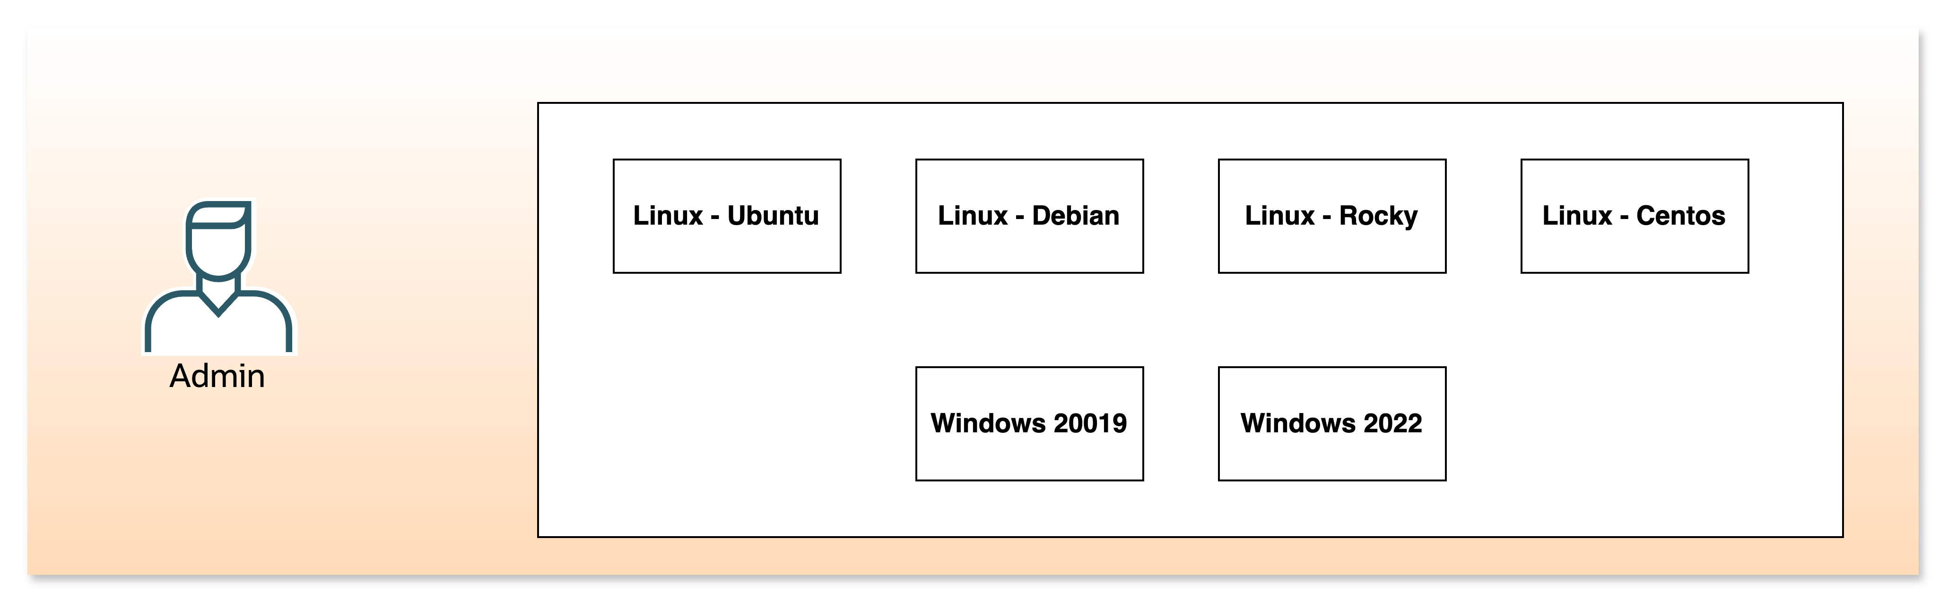
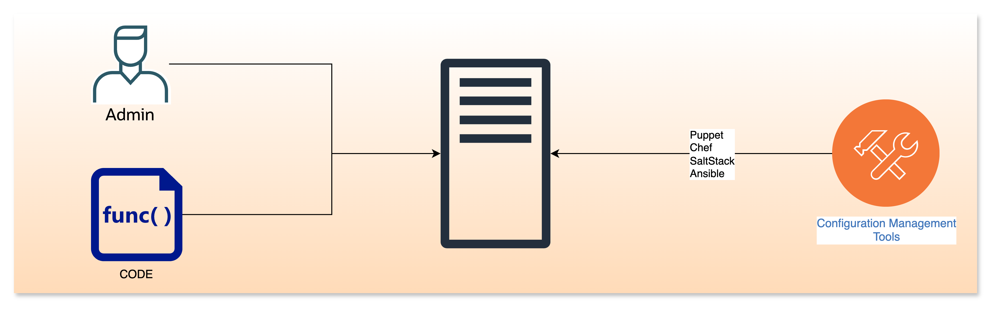
Configuration Management
Configuration management (CM) is a systematic process used to establish and maintain consistency of a product or infrastructure.
Configuration management ensures that all hardware, software, along with network resources are identified, tracked, and maintained in a known desired state
The configuration management ensure the processes are transparent and documented when the changes are performed on the resources.
Popular Tools: Ansible, Chef, SaltStack, Puppet and others automate and manage configurations at scale

Slide 3
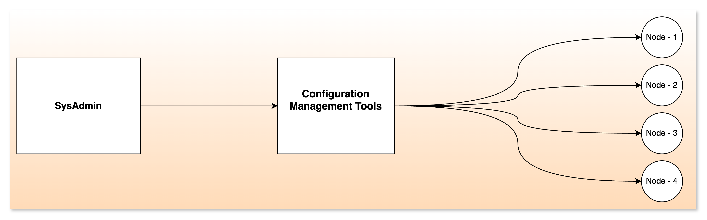
Why Is Configuration Management Required ?
Consistency: Maintains a stable, predictable environment by enforcing a known baseline configuration across systems.
Compliance: Helps organizations meet security, regulatory, and operational requirements by documenting and controlling changes.
Efficiency: Automates repetitive tasks, reduces manual errors, and streamlines deployment and updates.
Risk Reduction: Detects and remediates configuration drift (deviation from the desired state), minimizing outages and vulnerabilities.

Slide 4
Challenges with Puppet, Chef & SaltStack
Steep Learning Curve: All three tools require significant expertise—Puppet and Chef need knowledge of their DSLs (Puppet DSL, Ruby for Chef), while SaltStack’s architecture can be complex for beginners.
Complex Setup and Maintenance: Puppet and Chef involve intricate installation and ongoing management, including managing agents and master servers. SaltStack’s architecture and frequent updates can add to maintenance challenges.
Performance and Scalability Issues: Puppet’s agent-based model can consume significant resources and slow down with scale. Chef’s pull-based scheduling may delay configuration changes. SaltStack may face instability due to rapid updates.
Agent Dependency and Architecture Limitations: Puppet and Chef rely on agents installed on managed nodes, increasing overhead and potential points of failure. Puppet’s master server can be a single point of failure.
Delayed Configuration Enforcement: Puppet and Chef operate on pull-based models, meaning changes are applied periodically rather than instantly, which can delay critical updates.

Slide 5
Ansible
Ansible was first released by Michael DeHaan in 2012 as a small side project. RedHat acquired the Ansible tool in 2015.
Ansible uses YAML files as its main source of information at run time. YAML is a data serialization and representation language that is commonly used for configuration in ansible.
Ansible is written entirely in Python. The main runner and all of the modules are Python 2.6 compatible, which means that they’ll work with any version of Python2 above version 2.6.
Ansible works by running commands via SSH or WinRM, so there’s no need to install any server software. SSH or WinRM is used to login to the managed node and install the required packages/dependencies

Slide 6
Ansible - Key Features
Agentless, Simple & Powerful: Ansible installs and updates packages or configurations without requiring any CPU- or memory-intensive daemons running in the background, making it truly agentless.
Its cross-platform support, lightweight, version-controlled playbooks, orchestrate large environments and human-readable automation enable straightforward yet powerful infrastructure deployment and configuration management with Ansible.

Slide 7
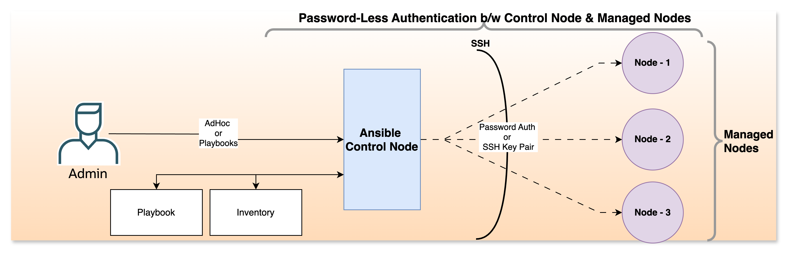
Ansible - Working
Ansible works by connecting to your remote nodes and pushing out small programs called Ansible modules to them.
These modules are designed to be idempotent, meaning that they only make changes if necessary to bring the system to the desired state.
After execution, these modules are removed. Ansible does not require any software (agents) to be installed on the nodes, which simplifies management.

Slide 8
Ansible - Workflow
Inventory Selection: Ansible reads the inventory file to determine which nodes to manage.
Connection: Ansible connects to the managed nodes via SSH or other configured transport methods (like Kerberos).
Module Transfer: Ansible pushes the necessary modules to the managed nodes.
Module Execution: The modules are executed on the managed nodes to perform the tasks defined in the playbook.
State Check: Ansible checks the state of the system after the module execution to ensure that the desired state has been achieved.
Cleanup: The modules are removed from the managed nodes after execution.
Reporting: Ansible provides reports on the status of each task and node, indicating success or failure.

Slide 9
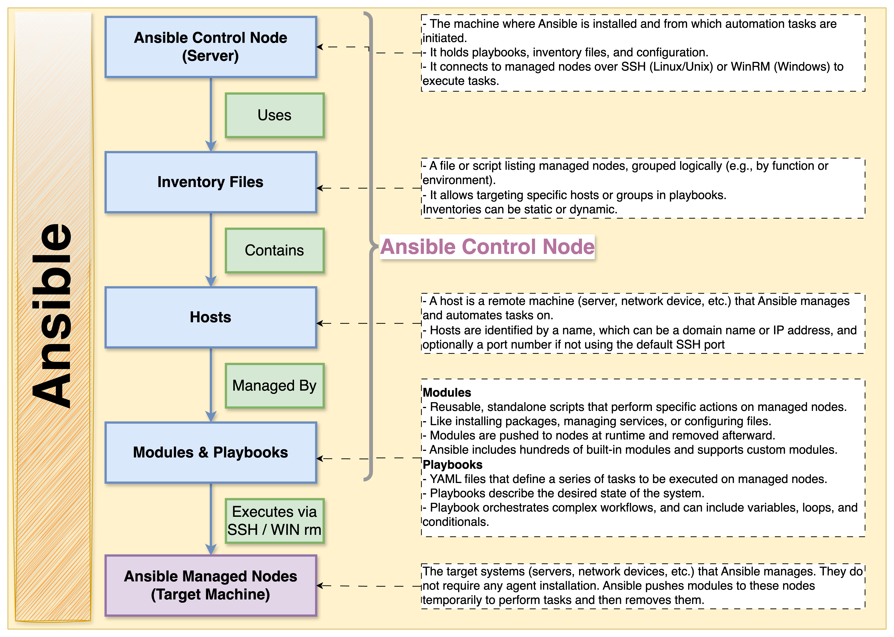
Ansible - Architecture

Slide 10
Ansible – Key Components
Control Node: The machine where Ansible is installed and from which playbooks are executed.
Inventory: A list of managed nodes, organized into groups, that Ansible can manage. This can be a simple text file or a more dynamic source.
Modules: Reusable, standalone scripts that Ansible uses to perform tasks on managed nodes.
Tasks: A single unit of action in Ansible. Each task calls a specific module with specific arguments.
Playbooks: YAML files that define the desired state of your systems. They contain an ordered list of tasks to be executed on managed nodes.
Managed Nodes: The servers, network devices, or other systems that Ansible manages.

Slide 11
Ansible – Installation – Control Node
Operating System | Installation Method | Key Commands / Steps
Ubuntu / Debian | Use APT with Ansible PPA | 1. sudo apt update && sudo apt upgrade -y 2. sudo apt install software-properties-common 3. sudo add-apt-repository --yes --update ppa:ansible/ansible 4. sudo apt install ansible -y 5. ansible --version
Red Hat / RHEL / CentOS | Use YUM/DNF and EPEL repository | RHEL: 1. sudo yum update -y 2. sudo dnf install -y ansible-core 3. ansible --version CentOS: 1. sudo yum update -y 2. sudo yum install epel-release 3. sudo yum install ansible 4. ansible --version

Slide 12
Ansible – Installation – Control Node
Operating System | Installation Method | Key Commands / Steps
Fedora | Use DNF package manager | sudo dnf install ansible
Arch Linux | Use pacman package manager | Full package: sudo pacman -S ansible Minimal core: sudo pacman -S ansible-core
MacOS | Use Homebrew | 1. brew update 2. brew install ansible 3. ansible --version
PIP | Install via pip [Python Package Index (PyPI)] | python –m pip install --user ansible

Slide 13
Ansible – SSH Ansible User Configuration – Managed Node
Steps | Command (from Control Node) | Purpose
Create user | ssh remote_user@remote_server "adduser ansible" | Create new user on Server B
Sudo group | ssh remote_user@remote_server "usermod -aG sudo/wheel ansible" | Add user to sudo group
Generate key | ssh-keygen -t rsa -b 4096 -f ~/.ssh/ansible_id_rsa | Generate SSH key pair locally (required only once)
Copy key | ssh-copy-id -i ~/.ssh/ansible_id_rsa.pub ansible@remote-server | Copy public key to remote user
Copy key (manual) | cat ~/.ssh/newuser_id_rsa.pub | ssh root@server_B_ip "mkdir -p /home/newuser/.ssh && cat >> /home/newuser/.ssh/authorized_keys && chown -R newuser:newuser /home/newuser/.ssh" | Copy public key to remote user manually
Test login | ssh -i ~/.ssh/ansible_id_rsa ansible@remote_server | Test SSH key login

Slide 14
Ansible – Inventory File
Inventory File serves as a database of your infrastructure, allowing you to organize and manage your servers, network devices, and other systems.
Inventory File Types:
Static Inventory
Dynamic Inventory
Note:
Ansible also supports dynamic inventories, where the list of hosts is generated dynamically from an external source such as a cloud provider (AWS, Azure, GCP) or a configuration management database (CMDB). Dynamic inventories are typically implemented using scripts or plugins that retrieve host information from these sources.

Slide 15
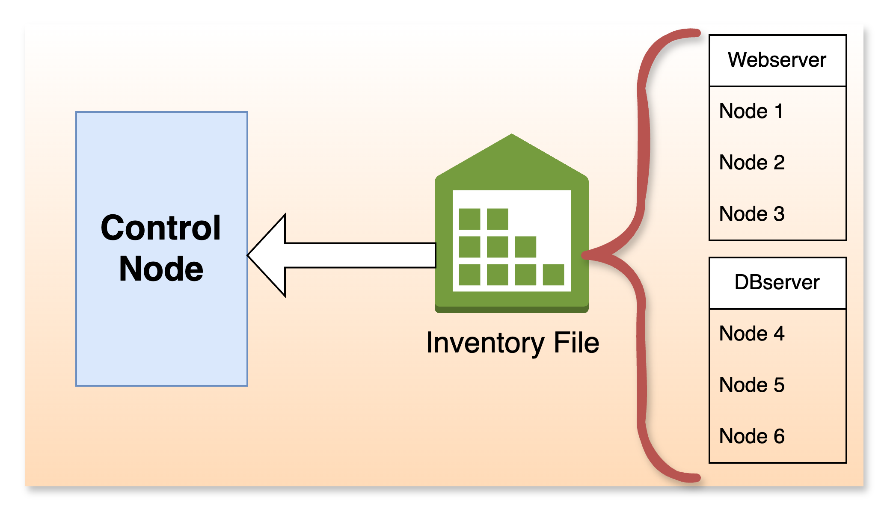
Basic Structure Inventory File Structure
Groups: Hosts can be organized into groups using square brackets [].
Hosts: Individual hosts are listed by their IP addresses or hostnames.
Example of Inventory File:
[groupname]
hostname1
hostname2

Slide 16
Key Aspects of Inventory File
Purpose: The inventory file tells Ansible which hosts to manage, how to access them, and allows you to organize hosts into groups.
Location: The default location is /etc/ansible/hosts, but you can specify a different inventory file using the ansible -i option when running ansible Adhoc commands or playbooks.
Format: The inventory file can be in INI or YAML format.

Slide 17
Ansible - Inventory File - Special Variables
ansible_host: The IP or DNS name to connect to (if different from group/host name)
ansible_port: SSH port (default 22)
ansible_user: SSH user
ansible_ssh_pass: SSH password (not recommended; use keys or vault)
ansible_ssh_private_key_file: Path to private key
ansible_python_interpreter: Python path on remote host
ansible_connection: Connection type ( ssh, local, docker, etc.)
ansible_become: Use privilege escalation ( yes/ no) (sudo)
ansible_become_user: Privilege escalation user
ansible_become_method: Method for privilege escalation ( sudo, su, etc.)
ansible_network_os: Network OS for network modules
ansible_ssh_common_args: These are command-line arguments that are always appended to the ssh command when Ansible connects to a managed host. Example: ansible_ssh_common_args='-o ForwardAgent=yes’
ansible_ssh_extra_args: These are command-line arguments that are appended to the ssh command, but unlike common_args, they are added after the configuration file is parsed. Example: ansible_ssh_extra_args='-o ConnectTimeout=10'

Slide 18
Ansible – Inventory File - Config Options
Option/Section | Description | Example/Syntax
Host entry | Hostname, FQDN, or IP address. Can include variables inline. | web1 ansible_host=1.2.3.4 ansible_user=admin
Group | Group hosts for collective targeting. | [webservers] or webservers: in YAML
Children | Nest groups within groups (hierarchical grouping). | [prod:children] webservers dbservers or children: in YAML
Host variables | Variables specific to a host, inline or in [host:vars] or under host in YAML. | ansible_port=2222 ansible_user=ubuntu
Group variables | Variables for all hosts in a group, in [group:vars] or under vars: in YAML. | [webservers:vars] ansible_python_interpreter=/usr/bin/python3
All group | Implicit group containing every host. | [all] or all: in YAML

Slide 19
Ansible - Inventory File – Types - .ini & .yaml
# inventory.ini File
# Hosts can be listed directly or grouped
web1.example.com
db1.example.com
# Group
[webservers]
web1.example.com web2.example.com ansible_host=192.168.1.20 ansible_port=2222
[dbservers]
db1.example.com
db2.example.com
# Group variables
[webservers:vars]
ansible_user=ubuntu
ansible_ssh_private_key_file=~/.ssh/id_rsa
# Children groups (nesting)
[prod:children]
webservers
dbservers
# All group variables
[all:vars]
company_name=examplecorp
# inventory.yaml File
all:
# All group variables
hosts:
web1.example.com:
ansible_user: ubuntu
ansible_port: 2222
web2.example.com:
# Children groups (nesting)
children: webservers:
hosts:
web1.example.com:
web2.example.com: # Group variables
vars:
ansible_python_interpreter: /usr/bin/python3
# Group
dbservers:
hosts:
db1.example.com:
db2.example.com:

Slide 20
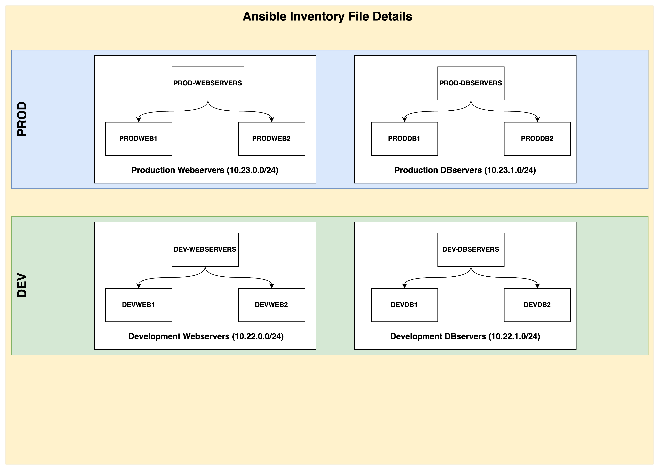
Ansible – Inventory File - Example

Slide 21
Ansible – Example - Inventory .ini File
# Development Webservers (10.22.0.0/24)
[dev_webservers]
devweb1 ansible_host=10.22.0.11 ansible_user=ansible fqdn=devweb1.anblab.local
devweb2 ansible_host=10.22.0.12 ansible_user=ansible fqdn=devweb2.anblab.local
# Development DBservers (10.22.1.0/24)
[dev_dbservers]
devdb1 ansible_host=10.22.1.21 ansible_user=ansible fqdn=devdb1.anblab.local
devdb2 ansible_host=10.22.1.22 ansible_user=ansible fqdn=devdb2.anblab.local
# Production Webservers (10.23.0.0/24)
[prod_webservers]
prodweb1 ansible_host=10.23.0.31 ansible_user=ansible fqdn=prodweb1.anblab.local
prodweb2 ansible_host=10.23.0.32 ansible_user=ansible fqdn=prodweb2.anblab.local
# Production DBservers (10.23.1.0/24)
[prod_dbservers]
proddb1 ansible_host=10.23.1.41 ansible_user=ansible fqdn=proddb1.anblab.local
proddb2 ansible_host=10.23.1.42 ansible_user=ansible fqdn=proddb2.anblab.local
# Logical groupings using: children
[Webservers:children]
dev_webservers
prod_webservers
[DBservers:children]
dev_dbservers
prod_dbservers
[DevServers:children]
dev_webservers
dev_dbservers
[ProdServers:children]
prod_webservers
prod_dbservers

Slide 22
Ansible – Example - Inventory .YAML File
all:
children:
dev_webservers:
hosts:
devweb1:
ansible_host: 10.22.0.11
ansible_user: ansible
fqdn: devweb1.anblab.local
devweb2:
ansible_host: 10.22.0.12
ansible_user: ansible
fqdn: devweb2.anblab.local
dev_dbservers:
hosts:
devdb1:
ansible_host: 10.22.1.21
ansible_user: ansible
fqdn: devdb1.anblab.local
devdb2:
ansible_host: 10.22.1.22
ansible_user: ansible
fqdn: devdb2.anblab.local
prod_webservers:
hosts:
prodweb1:
ansible_host: 10.23.0.31
ansible_user: ansible
fqdn: prodweb1.anblab.local
prodweb2:
ansible_host: 10.23.0.32
ansible_user: ansible
fqdn: prodweb2.anblab.loca
prod_dbservers:
hosts:
proddb1:
ansible_host: 10.23.1.41
ansible_user: ansible
fqdn: proddb1.anblab.local
proddb2:
ansible_host: 10.23.1.42
ansible_user: ansible
fqdn: proddb2.anblab.local
Webservers:
children:
dev_webservers:
prod_webservers:
DBservers:
children:
dev_dbservers:
prod_dbservers:
DevServers:
children:
dev_webservers:
dev_dbservers:
ProdServers:
children:
prod_webservers:
prod_dbservers:l

Slide 23
Ansible – AdHoc – Command Structure
ansible [pattern] -i [inventory] -m [module] -a "[module options]" [options]
Option | Description
[pattern]: | Host/group pattern from inventory
-i | Specify inventory file
-m | Module name (e.g., ping, shell, copy)
-a | Module arguments
-u | SSH username
-b | Become (sudo)
--become-user | Specify user to become
-k | Prompt for SSH password
-K | Prompt for become password
--limit | Limit execution to hosts matching pattern
-f | Number of parallel forks
--check | Dry run (check mode)
-v/-vv/-vvv | Increase verbosity

Slide 24
Ansible – Modules
List all modules: ansible-doc -l or ansible-doc -L
Module | Purpose | Example Usage
ping | Test connectivity | ansible all -m ping
command | Run commands (default module) | ansible webservers -a "uptime"
shell | Run shell commands (with pipes, redirects, etc.) | ansible all -m shell -a "echo $PATH"
copy | Copy files to remote hosts | ansible all -m copy -a "src=/tmp/foo dest=/tmp/foo"
file | Manage files/directories (permissions, state) | ansible all -m file -a "dest=/tmp/bar mode=600 state=touch"
package | Generic package manager (cross-platform) (yum, apt) | ansible all -m package -a "name=git state=present"
service | Manage services | ansible all -m service -a "name=nginx state=started"
user | Manage user accounts | ansible all -m user -a "name=alice state=present"
setup | Gather facts about hosts | ansible all -m setup

Slide 25
Ansible – AdHoc – Command Usage
Ping all servers: ansible all -i inventory.ini -m ping
Ping all production servers: ansible ProdServers -i inventory.ini -m ping
Ping all development webservers: ansible dev_webservers -i inventory.ini -m ping
Check uptime on all webservers: ansible Webservers -i inventory.ini -m shell -a "uptime”
Check disk usage on all DB servers: ansible DBservers -i inventory.ini -m shell -a "df -h”
Gather system facts from all prod DB servers: ansible prod_dbservers -i inventory.ini -m setup
Get hostname from all development DB servers: ansible dev_dbservers -i inventory.ini -m command -a "hostname”
Reboot all production webservers: ansible prod_webservers -i inventory.ini -m reboot
Check free memory on all servers: ansible all -i inventory.ini -m shell -a "free -m”
List all hosts in the inventory: ansible-inventory -i inventory.ini --list

Slide 26
Ansible – AdHoc – Example
Installing Apache web server on Linux servers with Ansible AdHoc commands
Action | Red Hat/CentOS Command | Ubuntu/Debian Command
Install Apache | ansible Webservers -i inventory.ini -m package -a "name=httpd state=present" | ansible Webservers -i inventory.ini -m package -a "name=apache2 state=present"
Check Install | ansible Webservers -i inventory.ini -m shell -a "rpm -q httpd" | ansible Webservers -i inventory.ini -m shell -a "dpkg -l | grep apache2"
Start Apache Service | ansible Webservers -i inventory.ini -m service -a "name=httpd state=started" | ansible Webservers -i inventory.ini -m service -a "name=apache2 state=started"
Check Status | ansible Webservers -i inventory.ini -m shell -a "systemctl status httpd" | ansible Webservers -i inventory.ini -m shell -a "systemctl status apache2"
Stop Apache Service | ansible Webservers -i inventory.ini -m service -a "name=httpd state=stopped" | ansible Webservers -i inventory.ini -m service -a "name=apache2 state=stopped"
Remove Apache | ansible Webservers -i inventory.ini -m package -a "name=httpd state=absent" | ansible Webservers -i inventory.ini -m package -a "name=apache2 state=absent"

Slide 27
Ansible - Yaml
YAML (YAML Ain't Another Markup Language)
YAML is a human readable data serialisation language used for writing configuration files and data exchange between languages with different data types.
YAML can be used in conjunction with other programming languages.
Because of its accessibility & flexibility, YAML is used by Ansible to create automation processes, in the form of Ansible Playbooks.

Slide 28
Ansible – Yaml - Key Features
Key Features of YAML:
Human-friendly: Uses indentation and minimal punctuation for clarity.
Versatile: Supports complex data types and structures.
Language-independent: Works across various programming languages.
Widely used: Common in DevOps, CI/CD, and configuration management.

Slide 29
Ansible – Yaml – DataTypes
Data Types | Description | Example
Variables | Single value: string, integer, float, bool | make: Toyota year: 2022 is_electric: false
Lists | Ordered list (array) | - Air Conditioning - Bluetooth - Backup Camera List - In-Line colors: [Red, Blue, Black]
Dictionary | Key-value pairs (dictionary) | engine: type: petrol horsepower: 150 turbo: false
Multi-Line String | Use the pipe (|) for preserving line breaks. | description: | This car is designed for comfort and efficiency. It features advanced safety systems.
Anchor & Alias | Specify the Default values | default_features: &defaults - Air Conditioning - Power Steering sedan: features: <<: *defaults - Sunroof
Explicit Typing with Tags | Specifying the variable type while declaration | price: !!int 25000 is_new: !!bool true model: !!str Corolla

Slide 30
Ansible – Playbooks – Yaml Example
---
# Car configuration example
car:
make: Toyota
model: !!str "Corolla"
year: !!int 2022
is_electric: false
price: !ENV ${CAR_PRICE} # Variable substitution from environment
description: |
The Toyota Corolla is a compact sedan.
It is known for reliability and fuel efficiency.
features: &default_features # List & Default
- Air Conditioning
- Bluetooth
- Backup Camera
colors:
- Red
- Blue
- Black
engine: # Dictionary
type: petrol
horsepower: 150
turbo: false
# Placeholder for variable substitution, processed by Jinja2
owner: "{{ OWNER_NAME }}”
variants:
- name: Standard
features:
- Cloth Seats
<<: *default_features
- name: Premium
features:
- Leather Seats
- Sunroof
<<: *default_features
registration:
# Environment variable reference
number: "{{ CAR_REG_NUMBER }}"
state: "{{ CAR_REG_STATE }}"

Slide 31
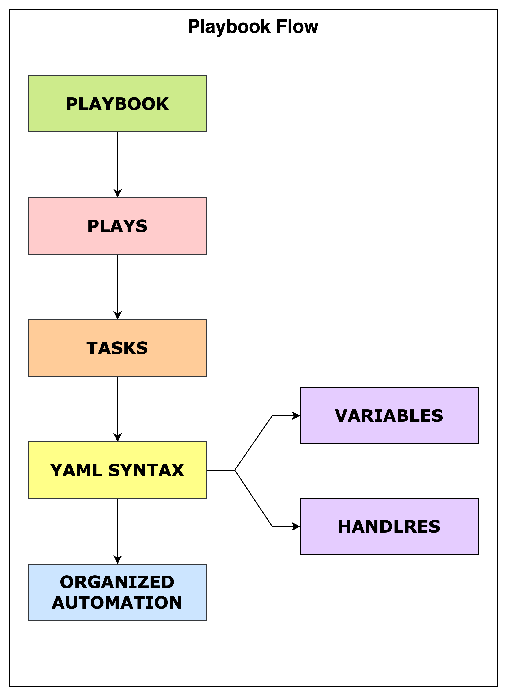
Ansible – Playbooks – Structure
Playbook Barebone Structure
---
- name: Playbook Name
hosts: target_group_or_host
become: true
tasks:
- name: Task 1
module_name:
option1: value1
option2: value2
- name: Task 2
module_name:
option1: value1

Slide 32
Ansible – Playbooks – Structure
Playbook Key Components:
—-: Indicates the start of the YAML document.
name: (Optional) Describes the play for readability.
hosts: Specifies the target hosts or groups.
become: (Optional) Runs tasks with elevated privileges (like sudo).
tasks: List of actions to perform, each using a module.
module_name: The Ansible module to use (e.g., apt, yum, service, copy), with its parameters

Slide 33
Ansible – Playbooks – Run Playbook
ansible-playbook playbook-name.yaml
ansible-playbook –i inventory_file.ini playbook_name.yaml
Option | Description | Example Usage | Complete Ansible Playbook Command
-i | Specify inventory file | -i hosts | ansible-playbook -i hosts playbook.yml
-u | SSH user for connecting to remote hosts | -u admin | ansible-playbook -u admin playbook.yml
-k | Prompt for SSH password | -k | ansible-playbook -k playbook.yml
-b | Become (use privilege escalation, e.g., sudo) | -b | ansible-playbook -b playbook.yml
-K | Prompt for privilege escalation password | -K | ansible-playbook -K playbook.yml
--check | Run in check mode (dry run, no changes made) | --check | ansible-playbook --check playbook.yml
--diff | Show differences when files are changed (useful with --check) | --diff | ansible-playbook --check --diff playbook.yml
-t | Run only tasks with specified tags | -t my_tag | ansible-playbook -t my_tag playbook.yml
-l | Limit execution to specific hosts or groups | -l webservers | ansible-playbook -l webservers playbook.yml
--start-at-task | Start playbook execution at a specific task name | --start-at-task="Install Apache" | ansible-playbook --start-at-task="Install Apache" playbook.yml
--step | Confirm each task before execution (step through playbook) | --step | ansible-playbook --step playbook.yml
--syntax-check | Perform a syntax check on the playbook without executing | --syntax-check | ansible-playbook --syntax-check playbook.yml
--ssh-common-args | Pass common arguments to SSH (e.g., for proxy or custom SSH options) | --ssh-common-args='-o ProxyCommand=...' | ansible-playbook --ssh-common-args='-o ProxyCommand=...' playbook.yml
--ssh-extra-args | Pass extra arguments to SSH only (overrides config) | --ssh-extra-args='-o ConnectTimeout=10' | ansible-playbook --ssh-extra-args='-o ConnectTimeout=10' playbook.yml

Slide 34
Ansible – Playbooks – Example: Install & Configure Nginx
---
- name: Configure web server
hosts: webservers
become: yes
vars:
app_port: 8080
tasks:
# Task 1: Install Nginx
- name: Install Nginx
ansible.builtin.apt:
name: nginx
state: latest
notify: Restart Nginx
# Task 2: Deploy Nginx configuration
- name: Deploy Nginx configuration
ansible.builtin.copy:
src: nginx.conf
dest: /etc/nginx/nginx.conf
notify: Reload Nginx
# Task 3: Ensure Nginx service is running and enabled
- name: Ensure Nginx service is running and enabled
ansible.builtin.service:
name: nginx
state: started
enabled: yes
handlers:
# Handler 1: Restart Nginx
- name: Restart Nginx
ansible.builtin.service:
name: nginx
state: restarted
# Handler 2: Reload Nginx
- name: Reload Nginx
ansible.builtin.service:
name: nginx
state: reloaded

Slide 35
Ansible – Playbooks – Example: Install & Configure SMTP and SFTP
Install And Configure SMTP & SFTP
Jinja Templet
---
- name: Configure SFTP and SMTP servers
hosts: all
become: yes
vars:
sftp_user: sftp_user
sftp_chroot_dir: /sftp/chroot
smtp_version: "1.8.22-1"
smtp_config:
account: default
host: smtp.example.com
port: 587
from: user@example.com
auth: on
user: smtp_user
password: "{{ vault_smtp_password }}"
tasks:
# SFTP Server Configuration
- name: Create SFTP chroot directory
ansible.builtin.file:
path: "{{ sftp_chroot_dir }}"
state: directory
owner: root
group: root
mode: '0755'
- name: Configure SSHd for SFTP
ansible.builtin.template:
src: sshd_config.j2
dest: /etc/ssh/sshd_config
notify: Restart SSH
# SMTP Server Installation
- name: Install specific msmtp version
ansible.builtin.apt:
name: "msmtp={{ smtp_version }}"
state: present
- name: Configure msmtp
ansible.builtin.template:
src: msmtprc.j2
dest: /etc/msmtprc
owner: root
group: root
mode: '0600'
notify: Reload msmtp
handlers:
- name: Restart SSH
ansible.builtin.service:
name: ssh
state: restarted
- name: Reload msmtp
ansible.builtin.command:
cmd: pkill -HUP msmtpd
Jinja Templet File (Ansible Built-in) # File: templates/sshd_config.j2
- name: SSHd Configuration Template
template: |
# Managed by Ansible - DO NOT EDIT MANUALLY
Subsystem sftp internal-sftp
Match User {{ sftp_user }}
ChrootDirectory {{ sftp_chroot_dir }}
ForceCommand internal-sftp
PasswordAuthentication yes
X11Forwarding no
AllowTcpForwarding no
# File: templates/msmtprc.j2
- name: msmtp Configuration Template
template: |
# Managed by Ansible - DO NOT EDIT MANUALLY
defaults
tls on
tls_trust_file /etc/ssl/certs/ca-certificates.crt
account {{ smtp_config.account }}
host {{ smtp_config.host }}
port {{ smtp_config.port }}
from {{ smtp_config.from }}
auth {{ smtp_config.auth }}
user {{ smtp_config.user }}
password {{ smtp_config.password }}

Slide 36
Ansible – Playbooks – Run Playbook & Example: Uninstall Nginx, SMTP & SFTP
Run Playbook
Uninstall Nginx, SMTP & SFTP
Directory Structure
playbook.yml
templates/
├── sshd_config.j2
└── msmtprc.j2
Create Templet Files
mkdir templates
# Paste SFTP template
vi templates/sshd_config.j2
# Paste SMTP template
vi templates/msmtprc.j2
Store SMTP password in Ansible Vault
ansible-vault encrypt_string 'your_password' --name 'vault_smtp_password
Run Playbook
ansible-playbook -i inventory playbook.yml --ask-vault-pass
---
- name: Remove services
hosts: all
become: yes
vars:
# SFTP variables
sftp_user: sftp_user
sftp_chroot_dir: /sftp/chroot
# SMTP variables
smtp_package: msmtp
tasks:
# NGINX Removal
- name: Remove NGINX and dependencies
ansible.builtin.apt:
name: nginx
state: absent
autoremove: yes
when: "'nginx' in ansible_facts.packages"
- name: Stop and disable NGINX service
ansible.builtin.service:
name: nginx
state: stopped
enabled: no
when: "'nginx' in ansible_facts.packages"
- name: Remove NGINX configs
ansible.builtin.file:
path: /etc/nginx
state: absent
when: "'nginx' not in ansible_facts.packages"
# SMTP Removal
- name: Remove msmtp
ansible.builtin.apt:
name: "{{ smtp_package }}"
state: absent
autoremove: yes
when: "'msmtp' in ansible_facts.packages"
# SFTP Configuration Reversal
- name: Remove SFTP chroot directory
ansible.builtin.file:
path: "{{ sftp_chroot_dir }}"
state: absent
when: ansible_facts.filesystem_mounts | selectattr('mount', 'match', sftp_chroot_dir) | list | count == 0
- name: Remove SMTP configuration
ansible.builtin.file:
path: /etc/msmtprc
state: absent
- name: Restore default SSH configuration
ansible.builtin.file:
path: /etc/ssh/sshd_config
state: absent
notify: Restart SSH
handlers:
- name: Restart SSH
ansible.builtin.service:
name: ssh
state: restarted

Slide 37
What is Ansible ROLES?
Ansible Role is a pre-organized folder structure to make your automation code clean, reusable, and modular.
Instead of writing everything inside one big playbook, roles break it into small parts: tasks, variables, handlers, templates, files, etc.
Easy to reuse roles in multiple projects
Ansible forces a standard folder layout inside a role. Because of this forced structure, your code is clean, consistent and understandable easily.

Slide 38
Ansible Playbook vs Ansible Roles
Ansible Playbooks | Ansible Roles
Playbooks are flat files where you manually define tasks, variables, handlers, templates all together. | Roles are a structured way to organize tasks, variables, handlers, templates, files separately.
When your project is small (few tasks), a simple playbook is enough. | When your project grows (many tasks, configs), roles make it manageable and modular.
Harder to reuse the same logic in other projects. | Easy to reuse roles across multiple playbooks and projects.
As playbooks get bigger, it becomes messy and hard to maintain. | Roles enforce a clean folder structure automatically — easier to maintain, debug, and collaborate.
No strict organization — you can mix anything anywhere. | Standardized layout — tasks, vars, templates are organized separately, making it professional.
Mostly for small-scale or quick jobs. | Best for medium to large-scale projects or when you want to follow best practices.

Slide 39
Ansible Role Structure
An Ansible role is defined by a standardized structure of subdirectories and files. The top-level directory defines the name of the role itself. Files are organized into subdirectories that are named according to each file's purpose in the role, such as tasks and handlers.
ansible-galaxy init user.example <this command basically creates the folder structure for the role>
[user@host roles]$ tree user.example
user.example/ <user.example is a role, and it can be any name based on play> ├── defaults
│ └── main.yml
├── files
├── handlers
│ └── main.yml
├── meta
│ └── main.yml
├── README.md
├── tasks
│ └── main.yml
├── templates
└── vars
└── main.yml

Slide 40
Ansible role subdirectories
SUBDIRECTORY | FUNCTION
defaults | The main.yml file in this directory contains the default values of role variables that can be overwritten when the role is used. These variables have low precedence and are intended to be changed and customized in plays.
files | This directory contains static files that are referenced by role tasks. Ex-index.html
handlers | The main.yml file in this directory contains the role's handler definitions.
meta | The main.yml file in this directory contains information about the role,including author, license, platforms, and optional role dependencies.
tasks | The main.yml file in this directory contains the role's task definitions.
templates | This directory contains Jinja2 templates that are referenced by role tasks.
tests | This directory can contain an inventory and test.yml playbook that can be used to test the role.
vars | The main.yml file in this directory defines the role's variable values. Often these variables are used for internal purposes within the role. These variables have high precedence, and are not intended to be changed when used in a playbook

Slide 41
Ansible Role Playbook
ansible-galaxy init apache_install
roles/apache_install/tasks/main.yml
- name: Install Apache HTTP Server
yum:
name: httpd
state: present
- name: Deploy custom index.html
template:
src: index.html.j2
dest: /var/www/html/index.html
- name: Start and enable Apache service
service:
name: httpd
state: started
enabled: yes
notify: Restart Apache
roles/apache_install/handlers/main.yml
- name: Restart Apache
service:
name: httpd
state: restarted
roles/apache_install/templates/index.html.j2
<html> <head><title>Welcome</title></head> <body> <h1>Hello from {{ apache_welcome_name }} server!</h1> </body> </html>
roles/apache_install/defaults/main.yml
apache_welcome_name: "My Awesome“
install_apache.yml - hosts: webservers become: yes roles: - apache_install
ansible-playbook -i inventory.ini install_apache.yml

Slide 42
Ansible – Configuration File
The Ansible configuration file (ansible.cfg) is a central file that controls the behavior and settings of Ansible.
Where is ansible.cfg Located?
Ansible looks for the configuration file in the following order (highest to lowest precedence):
ANSIBLE_CONFIG environment variable: If set, Ansible uses the file path specified here.
ansible.cfg in the current working directory: Useful for project-specific settings.
~/.ansible.cfg in the user’s home directory: For user-specific configurations.
/etc/ansible/ansible.cfg: The global system-wide default

Slide 43
Ansible – Configuration File - Creation
Location | Create ansible.cfg File
Custom path via ANSIBLE_CONFIG env variable | touch /your/path/ansible.cfg export ANSIBLE_CONFIG=/your/path/ansible.cfg
Current working directory | touch ./ansible.cfg
User's home directory (~/.ansible.cfg) | touch ~/.ansible.cfg
System-wide (/etc/ansible/ansible.cfg) | sudo touch /etc/ansible/ansible.cfg

Slide 44
Ansible – Configuration File – Common Sections
[defaults]
# Inventory file path.
inventory = ./inventory.cfg
# Remote user for SSH connections.
remote_user = admin
# Disable host key checking (for testing purposes only).
host_key_checking = False
fork = 5
[privilege_escalation]
# Enable privilege escalation (sudo).
become = True
# Method for privilege escalation.
become_method = sudo
# User to become (root).
become_user = root
[ssh_connection]
# Enable SSH connection multiplexing for faster connections.
# ControlMaster=auto: Reuse existing connections if available, otherwise create a new one.
# ControlPersist=60s: Keep master connection alive for 60s after the last client disconnects.
ssh_args = -o ControlMaster=auto -o ControlPersist=60s
[logging]
# Log file path.
log_path = /var/log/ansible.log

Slide 45
Ansible – Configuration File – Install Nginx
Inventory File (inventory.ini) [web]
10.22.0.11 # Replace with your server IP
Ansible.cfg
[defaults]
inventory = ./inventory.ini
host_key_checking = False
[privilege_escalation]
become = True
Ansible Commands
# Run PLaybook
ansible-playbook nginx_install.yml # Check active ansible.cfg
ansible --version | grep "config file" # Show inventory configuration
ansible-inventory --list
Playbook – install_nginx.ini
---
- name: Install and configure Nginx
hosts: web
become: yes
tasks:
- name: Update apt cache
apt:
update_cache: yes
- name: Install Nginx
apt:
name: nginx
state: latest
- name: Start and enable Nginx
service:
name: nginx
state: started
enabled: yes
- name: Copy test index.html
copy:
content: "Hello from Ansible!"
dest: /var/www/html/index.html

Slide 46
Ansible – Configuration File – Key Configuration Details
Component | Location | Verification Command
ansible.cfg | Current directory | ansible --version
Inventory | ./inventory.ini | ansible-inventory --graph
Playbook | Project directory | ls -l install_nginx.yml

Slide 47
Ansible - Vault
Ansible Vault encrypts sensitive data (passwords, keys) within playbooks, inventories, or variables.
Encrypt variables/files:
# Creates encrypted file
ansible-vault create secrets.yml
# Encrypts existing file
ansible-vault encrypt existing_unencrypted_secret_file.yml
File Structure
project/
├── ansible.cfg
├── inventory.ini
├── sftp_playbook.yml
└── secrets.yml # Encrypted with Vault

Slide 48
Ansible – Vault – Example: SFTP
ansible.cfg
[defaults]
inventory = ./inventory.ini
host_key_checking = False
# Optional password file
vault_password_file = ~/.vault_pass.txt
secrets.yaml
sftp_users:
- name: readonly_user
# Use `ansible-vault encrypt_string`
password: "$6$salt$encrypted_hash"
chroot: /sftp/readonly
- name: upload_user
password: "$6$salt$encrypted_hash"
chroot: /sftp/uploads
inventory.ini
[sftp_servers]
sftp-server.example.com

Slide 49
Ansible – Vault – Example: SFTP Playbook
---
- name: Configure SFTP Server with Chroot
hosts: sftp_servers
become: yes
vars_files:
- secrets.yml # Encrypted variables [8]
tasks:
- name: Install OpenSSH
apt:
name: openssh-server
state: latest
- name: Create SFTP groups
group:
name: "sftp_{{ item.chroot | basename }}"
state: present
loop: "{{ sftp_users }}"
- name: Create chroot directories
file:
path: "{{ item.chroot }}"
state: directory
owner: root
group: "sftp_{{ item.chroot | basename }}"
mode: 0755
loop: "{{ sftp_users }}"
- name: Configure SSH for SFTP
lineinfile:
path: /etc/ssh/sshd_config
line: "Subsystem sftp internal-sftp"
insertafter: EOF
- name: Add SFTP users
user:
name: "{{ item.name }}"
password: "{{ item.password }}"
group: "sftp_{{ item.chroot | basename }}"
shell: /usr/sbin/nologin
create_home: no
loop: "{{ sftp_users }}"
no_log: true # Hides password from logs [6]
- name: Restart SSH
service:
name: sshd
state: restarted

Slide 50
Ansible – Vault – Commands
Encrypt secrets:
# Encrypt with password
ansible-vault encrypt secrets.yml
Run playbook:
# Decrypt at runtime
ansible-playbook sftp_playbook.yml --ask-vault-pass
Verification
Check SFTP access:
# Test chroot access
sftp -P 22 readonly_user@sftp-server.example.com
Verify encrypted variables:
# View decrypted content
ansible-vault view secrets.yml
SSH config validation:
# Check SFTP server config
ansible sftp_servers -m shell -a "grep 'Subsystem sftp' /etc/ssh/sshd_config"

Slide 51
Ansible – Task Control
Task control in Ansible manages how and when tasks execute, enabling conditional logic, error handling, and workflow optimization. The task control can be achieved by using following options:
Conditionals
Loops
Handlers
Blocks
Execution Strategies

Slide 52
Ansible – Task Control – Conditionals (when)
Execute tasks only if specific conditions are met:
- name: Install Apache on Debian systems
ansible.builtin.apt:
name: apache2
state: present
when: ansible_facts['os_family'] == 'Debian'

Slide 53
Ansible – Task Control – Loops (loop)
Iterate over lists or variables:
- name: Install multiple packages
ansible.builtin.dnf:
name: "{{ item }}"
state: present
loop:
- git
- curl
- wget [8]

Slide 54
Ansible – Task Control – Handlers (notify/listen)
Handlers in Ansible are special tasks designed to run only when notified by other tasks during a playbook execution.
They provide an efficient way to perform actions that should happen only if a change occurs on the managed hosts, such as restarting a service after a configuration file has been updated.
task:
- name: Start and enable Nginx service
ansible.builtin.service:
name: nginx
state: started
enabled: yes
notify: Restart Nginx
handlers:
- name: Restart Nginx
ansible.builtin.service:
name: nginx
state: restart

Slide 55
Ansible – Task Control – Blocks (block, rescue, always)
block: Contains the main tasks to install and configure or make any changes on managed node.
rescue: Executes if any task in the block fails. In this case, it logs a failure message.
always: Always runs, regardless of whether the block or rescue sections were executed. Here, it ensures a log directory exists.
- name: Install a package and handle errors
hosts: web_servers
block:
- name: Install Apache
ansible.builtin.yum:
name: httpd
state: present
rescue:
- name: Log the failure
ansible.builtin.debug:
msg: "Apache installation failed!"
always:
- name: Ensure directory exists
ansible.builtin.file:
path: /var/log/apache_install
state: directory

Slide 56
Ansible – Task Control – Execution Strategies
Ansible's execution strategies control how a playbook is executed across multiple hosts. The configuration is added to the ansible.cfg file or to the playbook.yaml
Available Strategies:
linear (default): Executes each task on all hosts before moving to the next task. This ensures an orderly execution where all hosts complete a task before any host moves on.
free: Allows each host to run through the entire playbook as quickly as possible, without waiting for other hosts. This can be faster for independent tasks but may not be suitable for tasks that require a specific order.
serial: Executes the playbook in batches of hosts, defined by a number or percentage. For example, serial: 5 will execute the playbook on 5 hosts at a time. This is useful for rolling updates to minimize downtime.
forks: Sets the number of tasks that can run concurrently. The default is 5. Increasing this value can speed up execution.
throttle: Limits the number of workers for a specific task, up to the maximum set by forks or serial

Slide 57
Ansible – Task Control – Execution Strategies - Example
File: ansible.cfg
text
[defaults]
strategy = free # Control concurrency (number of parallel forks)
forks = 5
File: plabybook.yaml
---
- name: Simple Webserver Setup with Execution Strategies
hosts: webservers
become: yes
# Run on 2 hosts at a time (batch processing)
serial: 2
- name: Throttled task example
ansible.builtin.shell: echo "Running on {{ inventory_hostname }}"
throttle: 1

Slide 58
Ansible – Templates - Jinja2
Jinja2 uses {{ variable }} to insert variables and {% ... %} for control structures like loops and conditionals.
An Ansible template is a file used to dynamically generate configuration files or scripts on managed hosts, leveraging the Jinja2 templating language.
This allows you to insert variables, loops, and conditional logic into your configurations, making them reusable and customizable for different environments or scenarios.
Key Features:
Dynamic Content: Ansible templates generate files with runtime-specific data6.
Customization: They use variables and logic to create tailored configurations6.
Reusability: Write once and reuse templates across multiple tasks

Slide 59
Ansible – Templates - Example
playbook.yaml
---
- name: Configure Nginx
hosts: webservers
vars:
nginx_port: 80
nginx_server_name: example.com
nginx_root: /var/www/html
tasks:
- name: Deploy Nginx configuration
template:
src: nginx.conf.j2
dest: /etc/nginx/nginx.conf
mode: 0644
nginx.conf.j2
server {
listen {{ nginx_port }};
server_name {{ nginx_server_name }};
location {
root {{ nginx_root }};
index index.html;
}
}

Slide 60
Ansible – Oracle Cloud Infrastructure Ansible Collection
Oracle provides Ansible modules for most of the OCI services
https://docs.oracle.com/en-us/iaas/Content/API/SDKDocs/ansiblegetstarted.htm
Prerequisites
python >= 3.6
Package – oci-ansible-collection
Installation
Oracle Linux 8
sudo yum-config-manager --enable ol8_developer
sudo yum-config-manager --enable ol8_developer_EPEL
sudo yum install oci-ansible-collection
OCI Ansible Collection - https://docs.oracle.com/en-us/iaas/tools/oci-ansible-collection/5.4.0/index.html
https://github.com/oracle/oci-ansible-collection/tree/master

Slide 61
Ansible – Oracle Cloud Infrastructure Ansible Collection
Test - ansible localhost -m oracle.oci.oci_object_storage_namespace_facts
Sample playbook
[opc@ansible-ol8 ansible]$ cat list_vcn_apikey.yml
---
- name: List vcns
collections:
- oracle.oci
connection: local
hosts: localhost
tasks:
- name: List VCN
oci_network_vcn_facts:
compartment_id: "ocid1.compartment.oc1..XXXXX7f6uebei3wz4q"
region: "us-phoenix-1"
register: result
- name: Dump result
debug:
msg: '{{result}}’
Run - ansible-playbook list_vcn_apikey.yml

Slide 62
Ansible – Oracle Cloud Infrastructure Ansible Collection
Authentication
API Key Authentication
Having a CLI config file is mandatory for api_key.
Instance Principal
Delegation Auth – can be used when running via cloud shell
Resource Principal
Enable the inventory plugin
Add plugin in ansible.cfg file
[inventory]
# enable inventory plugins, default: 'host_list', 'script', 'auto', 'yaml', 'ini', 'toml'
enable_plugins = oracle.oci.oci

Slide 63
Ansible – Oracle Cloud Infrastructure Ansible Collection
Dynamic Inventory
Inventory Scenarios
Exclude Hosts from Inventory
Include Hosts from Inventory
Plugin documentation - ansible-doc -t inventory oracle.oci.oci
Idempotence in OCI Ansible Collection modules
Most of the operations supported by OCI Ansible Collection are idempotent by design i.e we check whether it is necessary to perform the tasks in the playbook.
Customising idempotence behaviour
Example Ansible Playbooks
Launching a Compute instance

Slide 64
Ansible – Customer Engagements

Slide 65
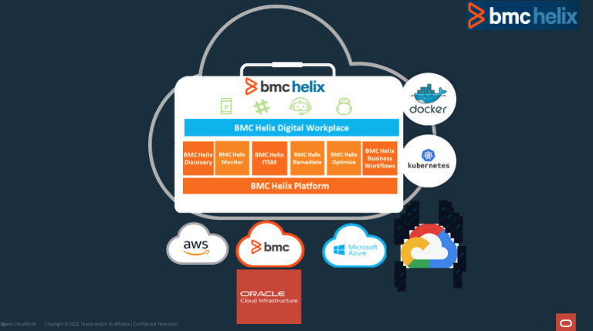
BMC– Elastic Search to OCI OpenSearch Migration
Migrate BMC Helix environments to the Oracle Cloud Infrastructure (OCI).
Migration to cloud infrastructure is driven by cost savings, levels of efficiency and BMC’s long-term goals.
Notes:
Other responder examples may include: Suspend User, Terminate Instance, Remove IP address
Notes : Targets and probably problems from console

Slide 66
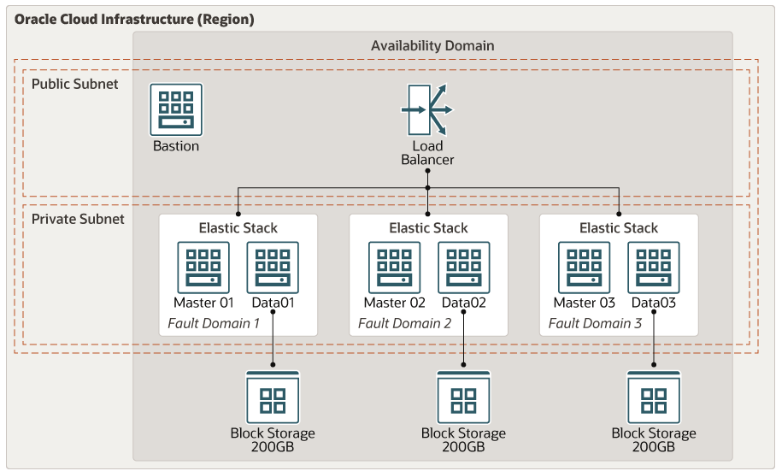
Elasticsearch
Elasticsearch is an open source, enterprise-grade search engine.
Elasticsearch can power quick searches that support your data discovery applications. It can scale thousands of servers and accommodate petabytes of data.
Notes:
Other responder examples may include: Suspend User, Terminate Instance, Remove IP address
Notes : Targets and probably problems from console

Slide 67
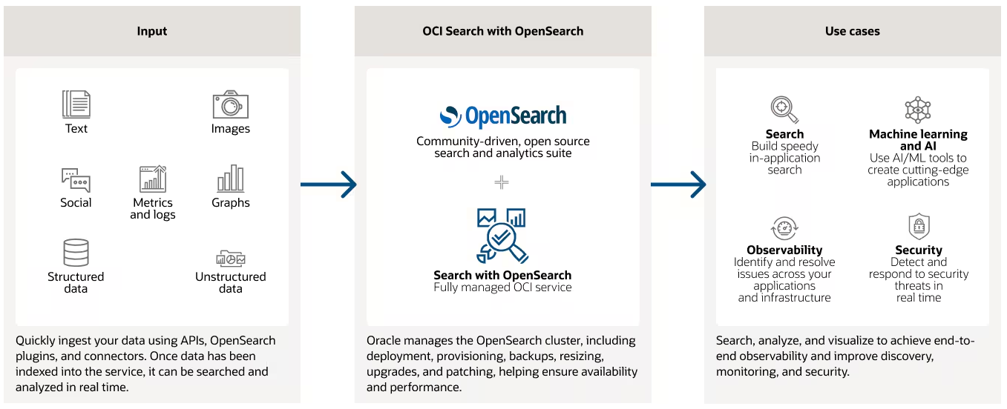
OCI OpenSearch
Migrate of Elastic Search Cluster to OCI OpenSearch
Notes:
Other responder examples may include: Suspend User, Terminate Instance, Remove IP address
Notes : Targets and probably problems from console

Slide 68
Install and Configure ElasticSearch
The OCI VM and Load Balancer provisioning corresponding to the Elasticsearch Open Distro clusters are provisioned using terraform, using the CD3 framework.
Block Volume - Create Logical volume, Volume group and Filesystem
Elasticsearch Open Distro install using RPM Package
Create the repository file
Java requirements - JDK
Install RPM Packages
Firewall Changes
Elasticsearch Configuration file - /etc/elasticsearch/elasticsearch.yml
Start and Enable Elasticsearch service
Notes:
Other responder examples may include: Suspend User, Terminate Instance, Remove IP address
Notes : Targets and probably problems from console

Slide 69
Ansible - Install and Configure ElasticSearch
Ansible Automation for Elasticsearch Opendistro installs, the menu based install script calls the ansible playbooks to create the environment based on the nodes specified
Playbook for creating the volume group, logical volumes and files systems attached to the ES Opendistro nodes
Install and configure the ES Opendistro cluster with 3 master and 3(+) data nodes
Playbook to change the passwords for the default users like admin, kibana etc
Change the log rotation policy and the log folder location
Playbook for Vertical and Horizontal scaling
Configure backup plugins and schedule backups
Notes:
Other responder examples may include: Suspend User, Terminate Instance, Remove IP address
Notes : Targets and probably problems from console

Slide 70
Ansible – Install and Configure ElasticSearch
Ansible Host Inventory file
#cluster name
cluster ash1esevenp1_cluster
perf_folder /lv01/perflog
#master role nodename ip
master ash1esevenp1m01 10.208.40.41
master ash1esevenp1m02 10.208.40.42
master ash1esevenp1m03 10.208.40.43
#data role nodename ip
data ash1esevenp1d01 10.208.40.38
data ash1esevenp1d02 10.208.40.39
data ash1esevenp1d03 10.208.40.40
#loadbalancer
lb lb_url_ip 10.208.40.41
#backup
backup oci_region us-ashburn-1
backup oci_tenancy id05dlqxf9gd
backup oci_bucket odfebmc_backup
backup m01cronflag no
Notes:
Other responder examples may include: Suspend User, Terminate Instance, Remove IP address
Notes : Targets and probably problems from console

Slide 71
Ansible – Install and Configure ElasticSearch
Check Server Connectivity – SSH
Create Inventory file - ./install.sh – choose q) quit
Create Logical volume, Volume group and Filesystem
[ash1-xjump-1 esod]$ansible-playbook -i ./inventory/hosts.esod lvm.yml
Install ES Open Distro
[bmeruva@ash1-xjump-1 esod]$ ./install.sh
Verifying nodes file....
****************************************
** 1) Install ES OpenDistro
** 2) Change Internal user password
** 3) Configure Backup Settings
** q) Quit
****************************************
Please enter a menu option or enter q to exit.
1
Option 1 Selected
Notes:
Other responder examples may include: Suspend User, Terminate Instance, Remove IP address
Notes : Targets and probably problems from console

Slide 72
Ansible – Install and Configure ElasticSearch
Change passwords for internal users - admin, kibanaserver, kibanaro logstash, readall, snapshotrestore
[bmeruva@ash1-xjump-1 esod]$ ./install.sh
Verifying nodes file....
****************************************
** 1) Install ES OpenDistro
** 2) Change Internal user password
** 3) Configure Backup Settings
** q) Quit
****************************************
Please enter a menu option or enter q to exit.
2
Option 2 Selected
Verify Cluster Access
ES Opendistro Backups
Support for Cluster changes - Patching
Support for Vertical and Horizontal scaling
Provisioned around 35 ES Clusters - nonProd and Prod ADE, CP/ITSM and Events ES OpenDistro environments using the ansible framework in different BMC regions
Notes:
Other responder examples may include: Suspend User, Terminate Instance, Remove IP address
Notes : Targets and probably problems from console

Slide 73
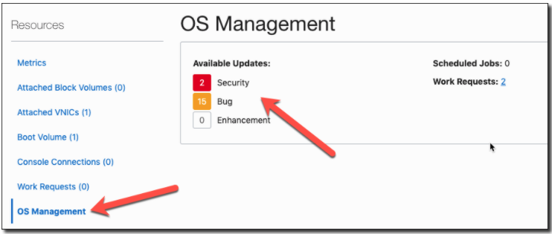
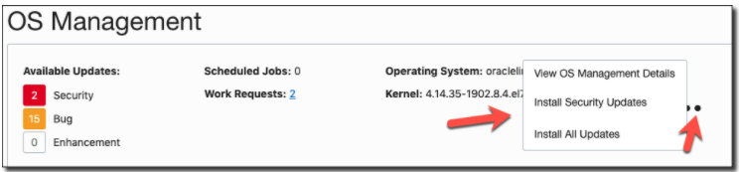
Integra - Oracle Cloud OS Management service (OSMS)
OSMS is an agent-based service. The agent must be installed in instances in order for the service to operate.
Instance metadata, Oracle agent and OSMS plugin
"data": { "agent-config": { "is-management-disabled": false,"is-monitoring-disabled": false}
Compute instance that is managed by OSMS is referred to as a Managed instance.
Managed Instance Group – Instance can be groups for simplified Fleet management
Software Source - OS Management uses software sources to provide packages to instances and to track the available updates to those packages.
Standard software sources are provided in the root compartment of the tenancy.
Custom Software Source - Custom software sources can be derived from the standard software sources or other custom sources. Custom sources enable you to create specific sets of packages that you want to manage and apply to instances.
Creating a Custom Software Source

Slide 74
Ansible Script to Reboot Servers after OSMS Patching
OSMS Managed instance groups enable you to group instances together for scheduling updates.
Ansible script to Reboot the servers listed in OSMS Managed instance groups after the Security patches are applied
[root@ansible-instanceol8 ansible]# ./osms_ansible_inventory.py -h
Usage: python osms_instance_reboot.py [-h] [-l] [-e envfile]
-h : help
-l : List OS Management Group Instances
-e : Specify the env file, the default config file is osms_instance_reboot.env
The OS Management Instance group details should be specified in the following Environment File
[root@ansible-instanceol8 ansible]# cat osms_ansible_inventory.env
[Default]
CompartmentID=ocid1.compartment.oc1..aaaaaaaazaclr4wlwgrf56jhgmyogytcykdelqm2to2afp2x4gqlcq4p2qza
ociconfig=
ociprofile=DEFAULT
os_management_group=hub_windows,hub_ol79
[root@ansible-instanceol8 ansible]# ./osms_ansible_inventory.py --list
{"group":{"hosts": ["SolarWindsServer","ansible-instance","grafana","OpenSCAP","testinstance79"],"vars": {"osms_instance_group": "hub_windows,hub_ol79"}},"_meta":{"hostvars":{"SolarWindsServer": {"instance_id":"ocid1.instance.oc1.iad.anuwcljswmzjseaceoq42mox53vbpmgfaotb454wqooeulikhwsku3wktq5a"},"ansible-instance": {"instance_id":"ocid1.instance.oc1.iad.anuwcljrwmzjseacp7zbzdu3rutzlxh32cfvlwda3vx3fgvsx2pdmbohflfa"},"grafana": {"instance_id":"ocid1.instance.oc1.iad.anuwcljtwmzjseachl56owh2yus5v7cnisdhratvf7gjcpufgsp5y3q7uqza"},"OpenSCAP": {"instance_id":"ocid1.instance.oc1.iad.anuwcljrwmzjseaclgugpxvyo3trbuwg62ezfv3eeqrrrfmhien4d3ajlfrq"},"testinstance79": {"instance_id":"ocid1.instance.oc1.iad.anuwcljtwmzjseacyphchairiowrhgiixykjydhckliu6g7hfhaajpyvkx4a"}}}}

Slide 75
Ansible Script to Reboot Servers after OSMS Patching
Reboot instance Ansible Playbook
[root@ansible-instanceol8 ansible]# cat oci_instance_reboot.yml
---
- name : Reboot servers
hosts: all
collections:
- oracle.oci
connection: local
gather_facts: no
tasks:
- name: Compute Instance Facts
oci_compute_instance_actions:
instance_id: "{{ instance_id }}"
action: reset
register: result
Running Reboot Script
[root@ansible-instanceol8 ansible]# ansible-playbook -i osms_ansible_inventory.py oci_instance_reboot.yml
PLAY [Reboot servers] ****************************************************************************************************
TASK [Compute Instance Facts] ********************************************************************************************
changed: [OpenSCAP]
changed: [grafana]
changed: [ansible-instance]
changed: [SolarWindsServer]
changed: [testinstance79]
PLAY RECAP ***************************************************************************************************************
OpenSCAP : ok=1 changed=1 unreachable=0 failed=0 skipped=0 rescued=0 ignored=0
SolarWindsServer : ok=1 changed=1 unreachable=0 failed=0 skipped=0 rescued=0 ignored=0
ansible-instance : ok=1 changed=1 unreachable=0 failed=0 skipped=0 rescued=0 ignored=0
grafana : ok=1 changed=1 unreachable=0 failed=0 skipped=0 rescued=0 ignored=0
testinstance79 : ok=1 changed=1 unreachable=0 failed=0 skipped=0 rescued=0 ignored=0

Slide 76
Integra – VM/ BareMetal Shape Migration
Oracle Cloud Infrastructure (OCI) periodically releases new generations of Compute shapes. The latest shapes let you take advantage of newer hardware and a better price-performance ratio. When a shape is several years old, and newer generation shapes that are suited for the same purposes are available, the old shape transitions to become a previous generation shape, refer to the link below.
https://docs.oracle.com/en-us/iaas/Content/Compute/References/computeshapes.htm#previous-generation-shapes__previous-generation-vo
SCOPE
We need to migrate approximately 100 instances from VM.Standard to E5 Flex, and from BM.Standard to BM.Standard.E5.192 since the orderability of VM.Standard ended on February 28, 2022. Therefore, we aim to migrate to the latest release.
Additionally, we need to migrate BM.Standard.E4.128 to M.Standard.E5.192, as the AMD E4 SKUs have reached End of Orderability
We want to perform a Proof of Concept (POC) for upgrading from Linux 7 to Linux 8. We are currently using OL7 on all servers, and since its end of life is on December 31, 2024, we plan to migrate all servers to Linux 8

Slide 77
Integra – VM/ BareMetal Shape Migration
Methodology and Approach
VM/ BareMetal Migration
You can change the shape of a virtual machine (VM) instance without having to rebuild the instance or redeploy your applications. However, there is the following Limitations for these compute instances
The image that was used to create the instance must be compatible with the new shape. To see which shapes are compatible, go to Instance Image and check the Shape Compatibility for in-place upgrade.
Due to this limitation, we must rebuild the instance from the E5 Flex gold image and restore the contents/applications. To bulk migrate these VMs, the VM Migration automation was developed using Ansible and Python scripts. The Salient features are
Migrates the Linux VMs
Create Mount folders and Mount all the Block Volumes and FSS NFS mounts. The Block Volume attachments for VM will be paravirtualized. For BareMetal’s the Block Volume attachment will be iSCSI.
Restore /etc files, like hosts, fstab , systemctl.conf and security files
Restore the users/Groups, home directories contents, /etc configuration and security files and the cron jobs

Slide 78
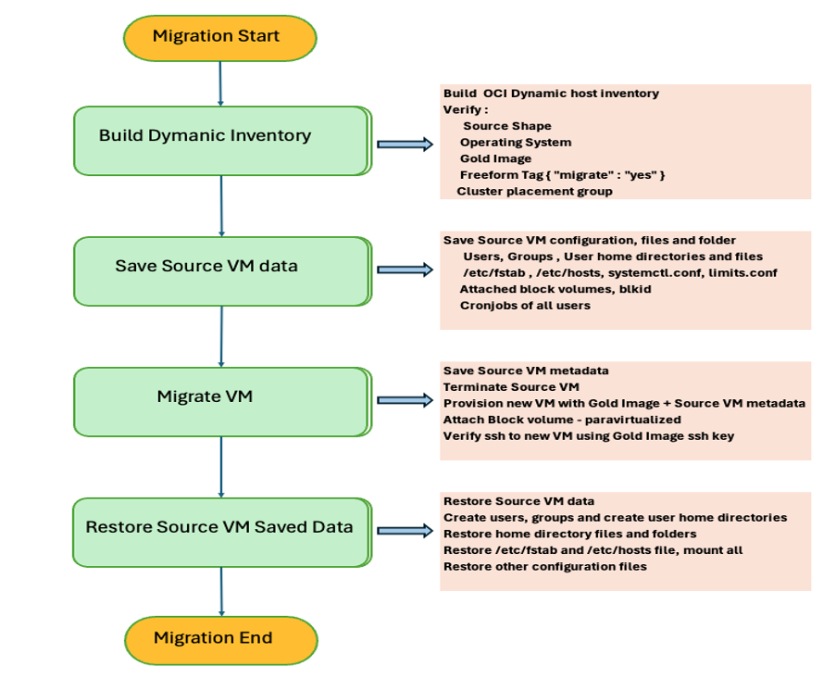
Integra – VM/ BareMetal Shape Migration
Notes:
Other responder examples may include: Suspend User, Terminate Instance, Remove IP address
Notes : Targets and probably problems from console

Slide 79
Integra – VM/ BareMetal Shape Migration
Environment file for VM Migration automation script: mig.env
##################################################################
#Global Environment file for the VM Upgrade
##################################################################
export RUN_FOLDER=/root/ansible/server_migration
export SAVE_FOLDER=${RUN_FOLDER}/save_folder
export LOG_FOLDER=${RUN_FOLDER}/logs
export PLAYBOOK_FOLDER=${RUN_FOLDER}/playbooks
##################################################################
# OCI Environment variables
##################################################################
CONFIG_FILE=~/.oci/config
CONFIG_PROFILE=DEFAULT
COMPARTMENT_OCID=ocid1.compartment.oc1..aaaaaaaas3ogp56w5brc5vtbgbgfc6huygz6gl7erwthaqy7jdg4ly2klufa
TARGET_IMAGE_OCID=ocid1.image.oc1.iad.aaaaaaaaxdqjsp6uls3pgrdkd6qx7r5gpydowtyyujpcxt6kmxhvt5shdbxa
OPERATING_SYSTEM=Linux
TAG="freeform.migrate.yes"
SOURCE_SHAPE=VM.Standard2.16
TARGET_SHAPE=VM.Standard.E5.Flex
SHARED_FOLDER=/stage/server_migration
SSH_PVTKEY_FOLDER=/root/ansible/oci_keys
TARGET_IMAGE_KEY=gold_image.key
CLUSTER_PLACEMENT_GROUP=none
REPLACE_VM=yes
Notes:
Other responder examples may include: Suspend User, Terminate Instance, Remove IP address
Notes : Targets and probably problems from console

Slide 80
Integra – VM/ BareMetal Shape Migration
Run the script – vmUpgrade.sh
[root@uspsanspr01 server_migration]# pwd
/root/ansible/server_migration
[root@uspsanspr01 server_migration]# ./vmUpgrade.sh
Run Folder : /root/ansible/server_migration
****************************************
** 1) VM Migrate Inventory
** 2) Prep VM before Migration
** 3) Migrate VM
** 4) Post VM Migration
** q) Quit
****************************************
Please enter a menu option and enter or enter q to exit.
1
Option 1 Selected
Run Menu Options to Migrate the VM Shape
All VMs from the OCI Compartment where the Freeform Tag migrate:yes will be processed
Verify the VM Migrations script logs from $LOG_FOLDER, you will find the Ansible playbook logs, Python script logs and the Migration logs.
Notes:
Other responder examples may include: Suspend User, Terminate Instance, Remove IP address
Notes : Targets and probably problems from console

Slide 81
Integra – OL7 to OL8 Migration
Upgrade Oracle Linux 7 (OL7) to Oracle Linux 8 (OL8)
Using Leapp
https://oracle-base.com/articles/linux/leapp-upgrade-ol7-to-ol8
Using VM Upgrade script
Create OL8 Gold Image
Run vmupgrade.sh script, sample migration environment file
##################################################################
#Global Environment file for the VM Upgrade
##################################################################
export RUN_FOLDER=/root/ansible/server_migration
export SAVE_FOLDER=${RUN_FOLDER}/save_folder
export LOG_FOLDER=${RUN_FOLDER}/logs
export PLAYBOOK_FOLDER=${RUN_FOLDER}/playbooks
##################################################################
# OCI Environment variables
##################################################################
CONFIG_FILE=~/.oci/config
CONFIG_PROFILE=DEFAULT
COMPARTMENT_OCID=ocid1.compartment.oc1..aaaaaaaazaclr4wlwgrf56jhgmyogytcykdelqm2to2afp2x4gqlcq4p2qza
TARGET_IMAGE_OCID=ocid1.image.oc1.iad.aaaaaaaa7vo5wpjqxq7mzwbxmg52wbitoguojz675xbzslfv76ooa5zhbeca
OPERATING_SYSTEM=Linux
TAG="freeform.migrate.yes"
SOURCE_SHAPE=VM.Standard.E5.Flex
TARGET_SHAPE=VM.Standard.E5.Flex
SHARED_FOLDER=/fss_folder
SSH_PVTKEY_FOLDER=/root/ansible/server_migration/keys
TARGET_IMAGE_KEY=gold_image.key
CLUSTER_PLACEMENT_GROUP=none
REPLACE_VM=yes
Notes:
Other responder examples may include: Suspend User, Terminate Instance, Remove IP address
Notes : Targets and probably problems from console

Slide 82
LACA – CISCAT Remediation
CIS-CAT (Configuration Assessment Tool) is a cybersecurity tool developed by the Center for Internet Security (CIS) to assess and improve the security posture of IT systems by comparing their actual configuration with recommended best practices from CIS Benchmarks.
[opc@elk cis-cat-full]$ sudo ./CIS-CAT.sh -r /report -t -csv --find
-----------------------------------------------------------------------
This is CIS-CAT-Pro Assessor version 3.0.70
Built on: 10/01/2020 05:02 AM
-----------------------------------------------------------------------
#1 -- CIS Amazon Elastic Kubernetes Service (EKS) Benchmark
#2 -- CIS Amazon Linux 2 Benchmark
#3 -- CIS Amazon Linux Benchmark
#4 -- CIS Apple OSX 10.12 Benchmark
……
…….
Selected CIS Oracle Linux 7 Benchmark
#1 -- xccdf_org.cisecurity.benchmarks_profile_Level_1_-_Server
#2 -- xccdf_org.cisecurity.benchmarks_profile_Level_2_-_Server
#3 -- xccdf_org.cisecurity.benchmarks_profile_Level_1_-_Workstation
#4 -- xccdf_org.cisecurity.benchmarks_profile_Level_2_-_Workstation
Which Profile should be used? (return to exit)
2
Selected Level 2 - Server
Add another benchmark? (Y/n/q)
n
Notes:
Other responder examples may include: Suspend User, Terminate Instance, Remove IP address
Notes : Targets and probably problems from console

Slide 83
LACA – CISCAT Remediation
Wrote Menu driven Ansible scripts to remediate the failed configuration items, the scripts can be run for a given sections or against the specific failed test items. This was accomplished by using Tags in the Ansible playbooks. The OS hardening of OL 7.x/8.x VMs can be done in 5-10 minutes with security score of +85% after running the Ansible remediation script.
[opc@testinstance79 cis-ol7-ansible]$ ./ciscat.sh
Verifying hosts file....
****************************************
Run script for the following hosts
10.250.0.2
****************************************
** 1) List tags for configuration items
** 2) Remediate Section
** 3) Remediate Specific Tags
** q) Quit
****************************************
Please enter a menu option and enter or enter q to exit.
1
Option 1 Selected
[WARNING]: file /home/opc/scripts/cis-ol7-ansible/roles/ciscat/tasks/section6_level2.yml is empty and had no tasks to include
playbook: ciscat.yml
play #1 (ciscatvm): ciscatvm TAGS: []
TASK TAGS: [scored, section1, section1.1, section1.1.22, section1.1.24, section1.3, section1.3.2, section1.3.3, section1.4, section1.4.1, section1.4.2, section1.5, section1.5.2, section1.6, section1.6.1, section1.6.3, section1.8, section1.8.1.2, section1.8.1.3, section2, section2.2, section2.2.1.2, section2.2.17, section2.2.2, section2.2.3, section2.2.4, section2.2.8, section2.3, section2.3.4, section3, section3.2, section3.2.1, section3.2.2, section3.3, section3.3.1, section3.3.2, section3.3.3, section3.3.4, section3.3.5, section3.3.6, section3.3.7, section3.3.8, section3.3.9, section3.4, section3.4.1, section3.4.2, section4, section4.1, section4.1.1.3, section4.1.10, section4.1.11, section4.1.12, section4.1.13, section4.1.14, section4.1.15, section4.1.16, section4.1.17, section4.1.2.2, section4.1.2.3, section4.1.2.4, section4.1.3, section4.1.4, section4.1.5, section4.1.6, section4.1.7, section4.1.8, section4.1.9, section4.2, section4.2.1.3, section4.2.1.5, section4.2.2.1, section4.2.2.2, section4.2.2.3, section4.2.3, section5, section5.1, section5.1.2, section5.1.3, section5.1.4, section5.1.5, section5.1.6, section5.1.7, section5.1.8, section5.1.9, section5.2, section5.2.10, section5.2.13, section5.2.14, section5.2.15, section5.2.16, section5.2.17, section5.2.18, section5.2.20, section5.2.21, section5.2.4, section5.2.6, section5.2.7, section5.3, section5.3.1, section5.3.4, section5.4, section5.4.1.1, section5.4.1.2, section5.4.1.4, section5.4.4, section5.4.5, section5.6]
ANSIBLE_LOG_PATH->/home/opc/scripts/cis-ol7-ansible/logs/option1_logs_20230217062940.log
Use Option 2 to Remediate Section(s), Option 3 to Remediate Tag(s).
Notes:
Other responder examples may include: Suspend User, Terminate Instance, Remove IP address
Notes : Targets and probably problems from console

